Slide 1
2024 - 2025
Beginner Parent Orientation

Slide 2
Mr. Nathaniel Bruner
Barton Chapel
Glenn Hills
Meadowbrook
Richmond Hill Elem

Slide 3
Mr. Chris Connolly
Belair Elementary
Sue Reynolds
Warren Road

Slide 4
Mrs. Amy Ellington
Copeland
Lake Forest Hills

Slide 5
Mrs. Rochelle Garman
Goshen
Hains
McBean

Slide 6
Mrs. Bonnie Harris
Deer Chase
Diamond Lakes
Freedom Park
Jamestown
Tobacco Rd.

Slide 7
Ms. JaVonne Jones
Monte Sano
Lamar-Milledge

Slide 8
Mr. Anthony McCullough
C.T. Walker
Garrett
Hornsby
Jenkins-White

Slide 9
Ms. Rachel Misner
Blythe
Gracewood
Hephzibah

Slide 10
Mrs. Alexandra Shelton
Bayvale
Wheeless Rd.
Wilkinson Gardens

Slide 11
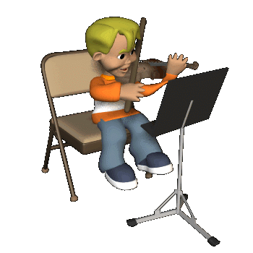
Music Stores
Antique Violins of Augusta
222 2nd St.
(706) 829-5530
Atlanta Strings
229 West Pike St.
(770) 338-5446

Slide 12
Music Stores
Kirkwood’s Music & Repair
206 Belair Rd.
706-863-1542
Portman’s Music Superstore
3946 Washington Road
706-738-1651

Slide 13
Music Stores
Music & Arts
3830 Washington Road– Suite 33
West Town Shopping Center
706-860-8600
Jay’s Music Center
3110 Washington Road
706-863-9575

Slide 14
Instrument Quality

Slide 15
WARNING!!!
Don’t make the mistake of acquiring the dreaded “V.S.O.” or the
Violin Shaped Object
WE ALLOW ONLY WOOD-GRAINED COLORED STRING INSTRUMENTS IN OUR PROGRAM

Slide 16
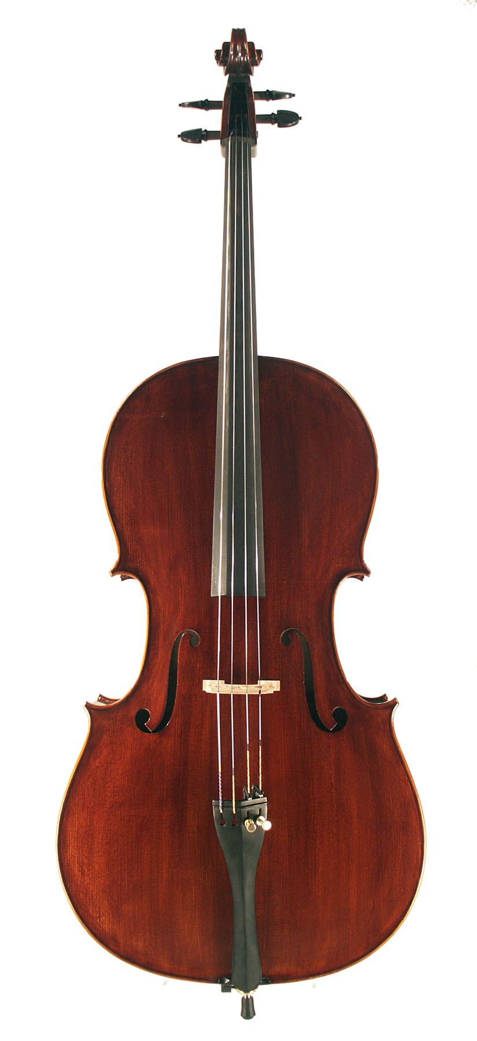
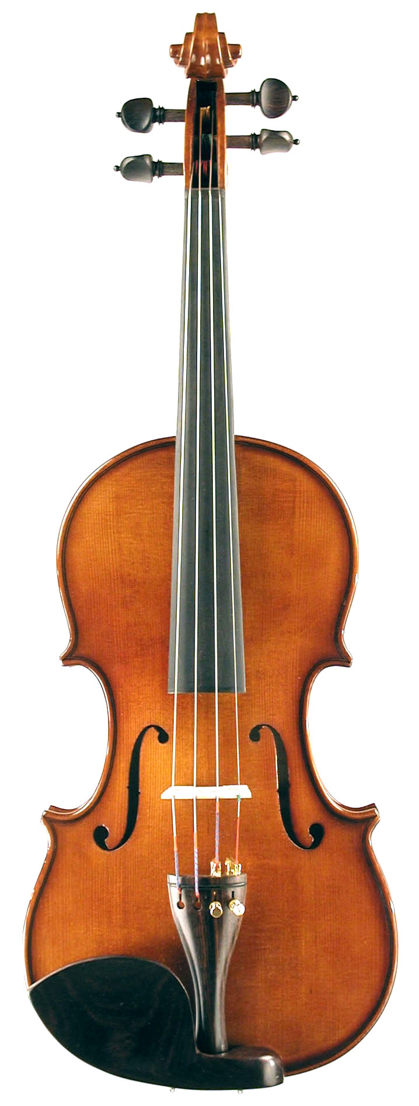
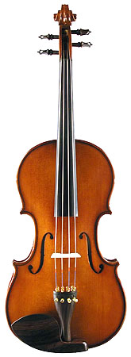
Instrument Sizing
violin
viola
cello

Slide 17
First Few Lessons

Slide 18
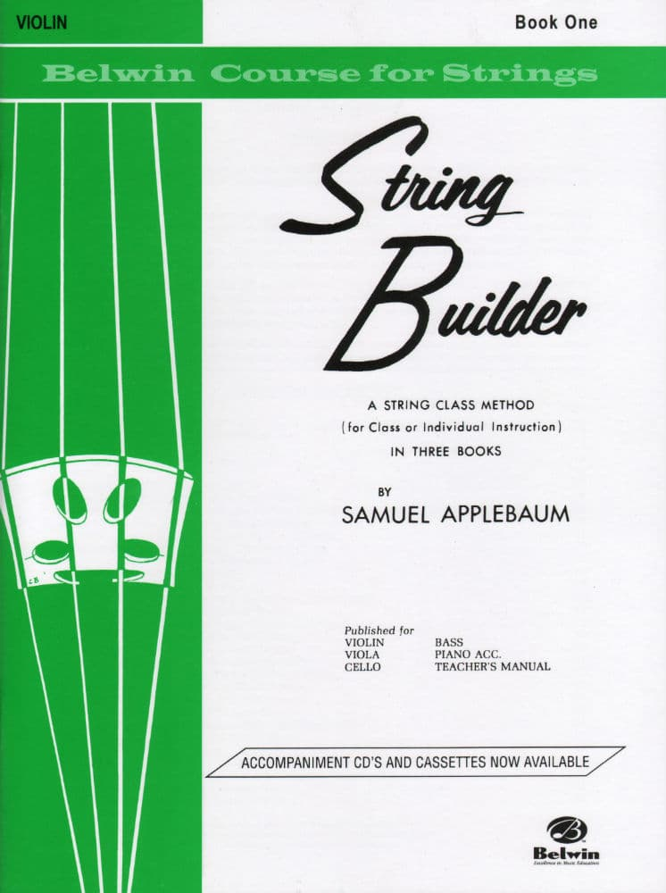
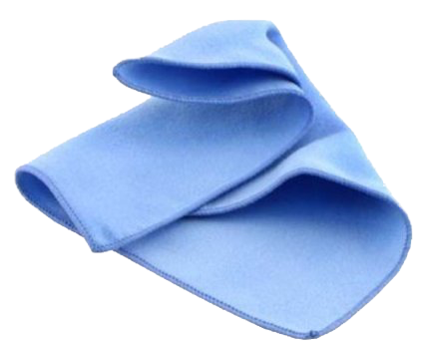
Essential Materials
music book
instrument
rosin
notebook
cleaning cloth
pencil

Slide 19
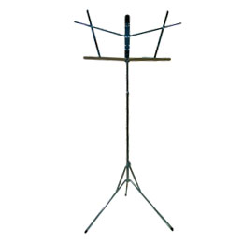
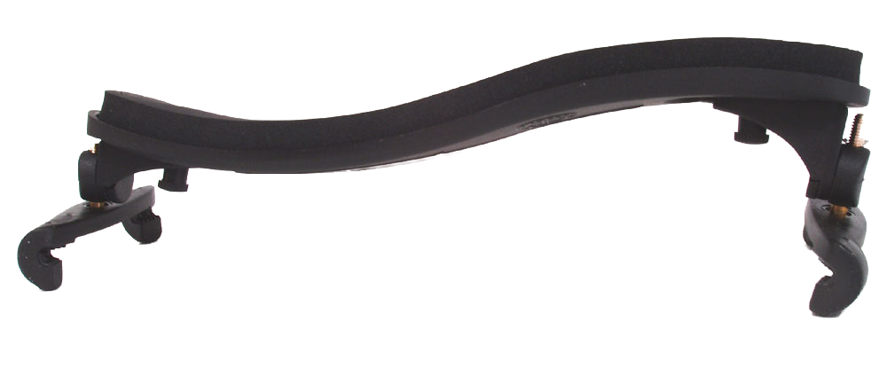
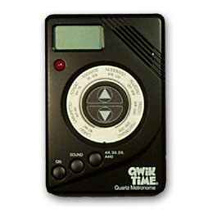
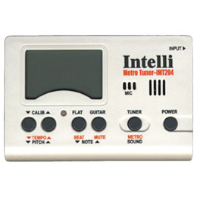
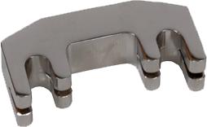
Optional Materials
metronome
shoulder rest
music stand
metal practice mute
Tuner /metronome

Slide 20
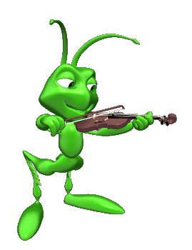
Individual Practice
Set goals (There is always something to work on.)
Keep a steady practice routine and use a practice log
Practice daily for 30 minutes
Start with a warm-up
Reinforce good habits
Practice sight-reading (after note-reading has been introduced)
Cool down
Evaluate
PRACTICE is the key to succeeding in string class!!!

Slide 21
Care and Repairs
Stringed instruments are not damage proof (strings may break, pegs may unwind, bridges may fall, bow hairs may become loose, etc.)
Some wear and tear is normal, and many situations can be handled by your child’s string teacher.
It is always best to consult your child’s string teacher before sending an instrument to the music store for repair.

Slide 22
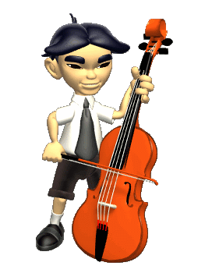
When do we start?
August 26 - August 30
Beginner Classes Start
September 9
Beginner Instrument Deadline
*It is preferred that your child have an instrument by the 1st string class.

Slide 23
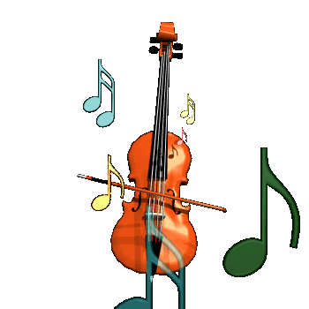
Important Dates
Thursday, September 5: PUTT- PUTT NIGHT
Thursday, November 7: FIDDLE FESTIVAL
@ Hephzibah Middle School
Monday, December 16: CHRISTMAS CONCERT
@ Augusta University - Summerville Campus
Tuesday, December 17: CHRISTMAS CONCERT
@ Augusta University - Summerville Campus

Slide 24
Important Dates
Thursday, January 30:ALL-COUNTY HONOR ORCHESTRA AUDITIONS
- Tubman Educational Learning Center
Thursday, March 6: ALL-COUNTY CONCERT
- Tubman Educational Learning Center-
Thursday, April 3: PUTT-PUTT FUN NIGHT
Thursday, May 1: SPRING CONCERT
- Tubman Educational Learning Center-

Slide 25
Parent Support
Supply all materials throughout the whole year right away as needed.
Use praise generously and sincerely.
Provide a quiet place for practicing, free of all distractions.
Place emphasis on consistent practice every day; 20 to 30 minutes at least five days a week.

Slide 26
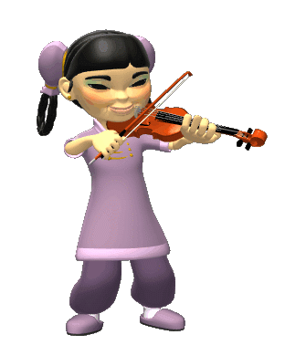
Parent Support
Organize a system to ensure your child has his/her instrument and book at every string class.
Read every handout/letter we send home. It is always going to be important.
Try to help your child memorize the easy familiar songs, so they can participate in all concerts.

Slide 27
2024-2025
Parent Orientation

